Slide 1
Estimating nutrient loads and other interesting news
Theron Miller, PhD
Wasatch Front Water Quality Council
Utah Lake Workshop
March 30, 2017

Slide 2
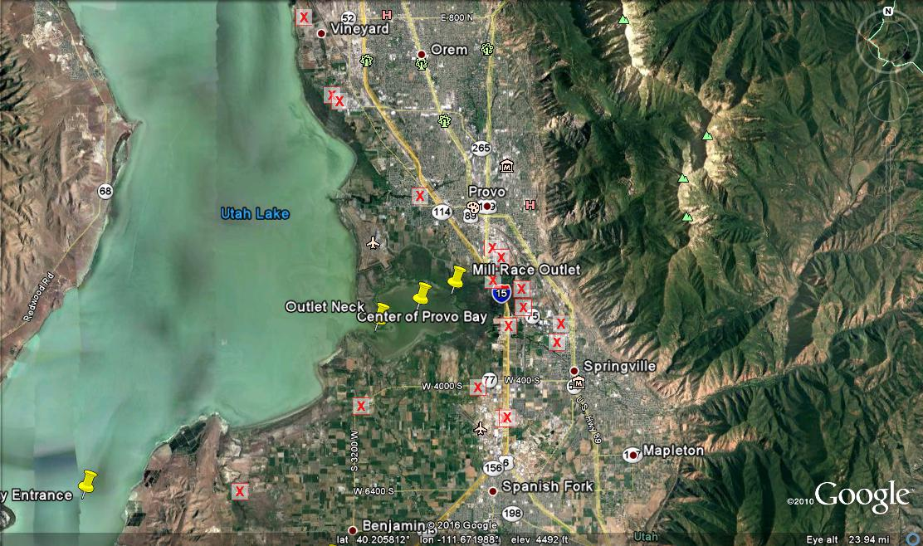
CUP/DWQ Sampling Sites, 2009 -2013

Slide 3
Tracking Nutrients Across Provo Bay
Phosphate in Mill Race
P Uptake by Sediments
Site | Date | NH4 | NO3-N | O-Po4 | TP | Dis. -P
Millrace Outlet | 6/16/2016 | 0.073 | 6.2 | 1.26 | 1.36 | 1.19
Provo Bay East | 6/16/2016 | 0.059 | 3.4 | 1.07 | 1.19 | 1.04
Mid Provo Bay | 6/16/2016 | 0.013 | 0.5 | 0.137 | 0.162 | 0.004
Provo Bay West | 6/16/2016 | 0.026 | 0.4 | 0.233 | 0.416 | 0.03
Provo Bay near outlet | 8/11/2016 | 0.518 | 0.5 | 0.465 | 0.542 | 0.254

Slide 4
Phosphorus
in Orem POTW Discharge and
Outlet of Powell Slough (edge of Utah Lake)
 | Mean: 2009 to 2012 | Mean: Nov, Dec, Jan, 2014/2015
Orem POTW (End of Pipe) | 3.68 | 1.31
Powell Slough Outlet (at Utah Lake) | - | 0.26

Slide 5
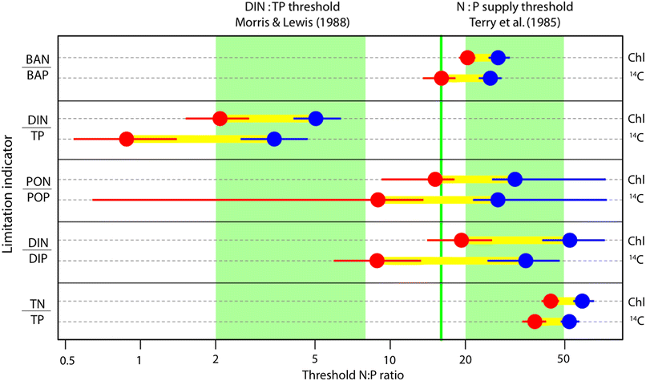
What is the best Nutrient Limitation Indicator?
Ptacnik et al. 2010. Ecosystems: 13 (8)1201-1214

Slide 6
Nutrient Ratios During the 2016 Bloom
Site | TN:TP | DIN:DIP | DIN:TP
Mid Goshen Bay | 26.3 | 15.1 | 0.1
Lincoln Beach Surface Scum | 21.6 | 66.8 | 0.5
Lincoln Beach 50 m/shore | 28.2 | 36.1 | 5.2
1000 m from Provo Bay | 7.3 | 2.9 | 1.0
In Provo Bay | 1.6 | 2.1 | 1.1

Slide 7
Atmospheric Deposition
(Early measurements in 2017)
(Approximately 0.15 mg/L in rain/snow)
96000 Acres = |  |  | Average Area of Utah Lake
192000 | acre ft |  | Average Depth = 2 ft (2016)
8256000000 | cubic ft |  | Volume
2.33645 E^11 | liters |  | Converted to liters
16 in. of Rainfall = 66.5 % or 2/3 of lake volume exists as rain
So 2/3 of the lake’s water already contains 0.15 mg/L = 34 tonnes of Loading
Even if diluted by 1/3 (= distilled water) |  |  |  | = 0.10 mg/L - just from
 |  |  |  |  | Atmospheric Deposition

